Slide 1

01
Real-Time Mobile Football Simulation
- Liam Flynn

Slide 2
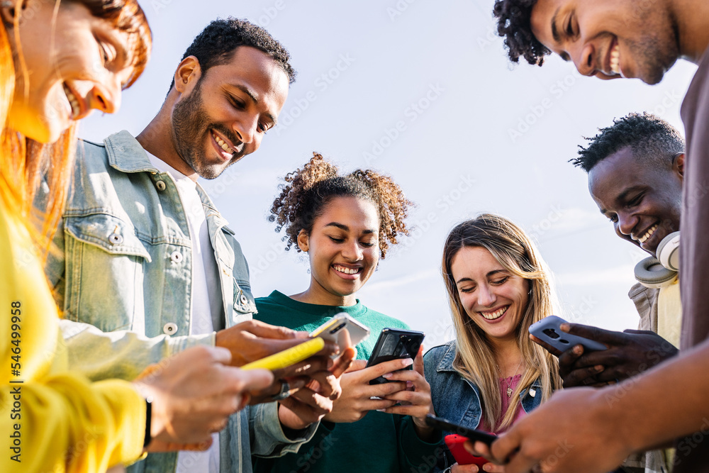
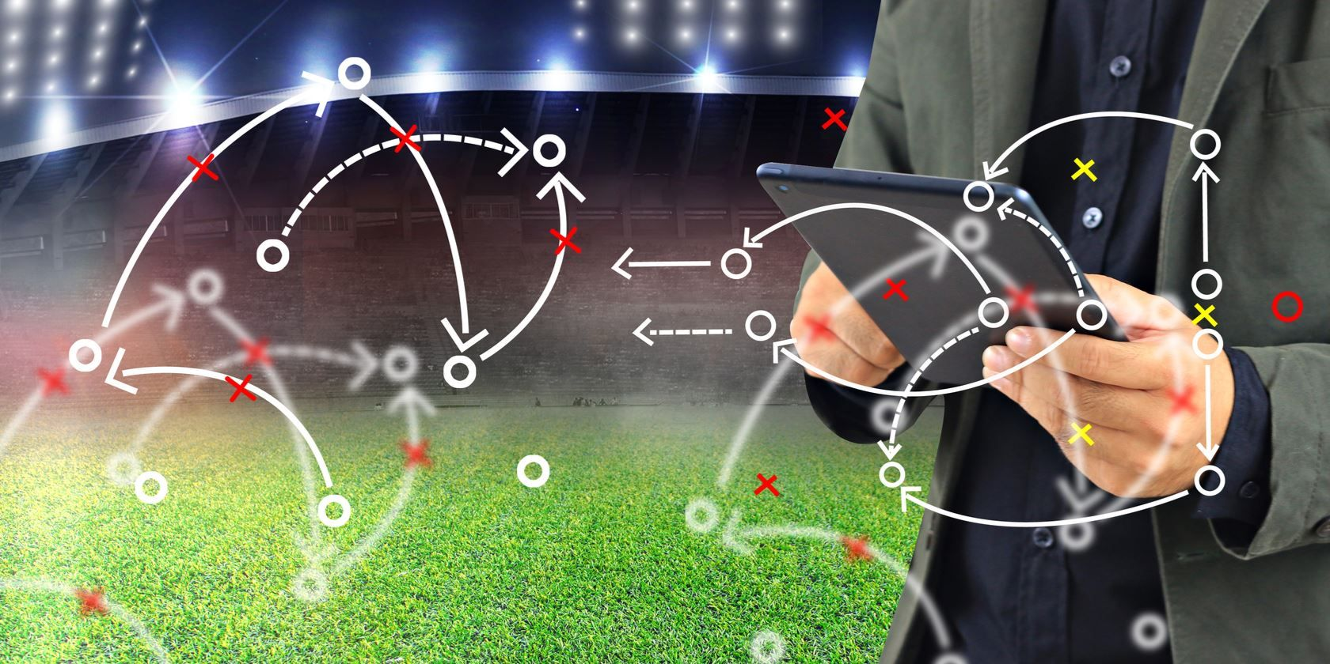
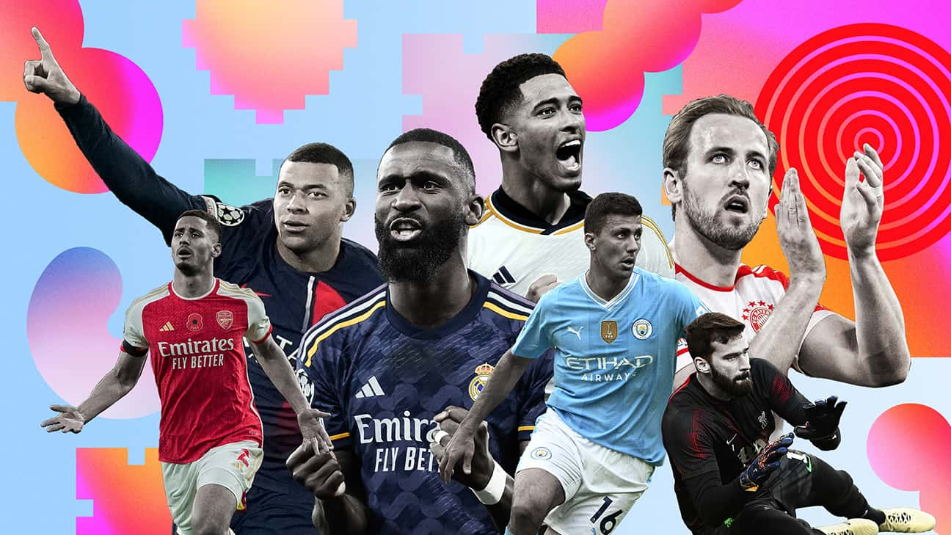
INTRODUCTION
Football Simulation
Social
Mobile Game
Real -Time
Data

Slide 3
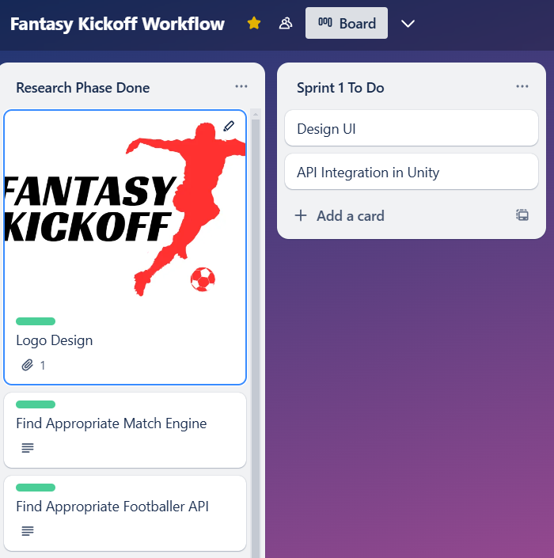




PROJECT MANAGEMENT
Trello
GitHub
Tools
Sprint & Workflow
Management
Version Control & Cloud
Backup
Used to Develop the
Game

Slide 4
Scope, Complexity & Innovation
Footballer Database
Multiplayer Matches
Quick Matches
Multiplayer Leagues
Team Management
User Profiles
Rewards
Dynamic Match Simulations
Footballers via Live API
Dynamic Weather Integration
Dynamic League Updates
User Customisation

Slide 5
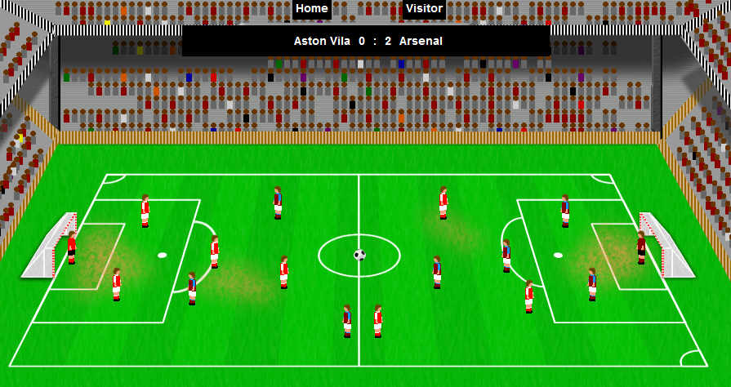
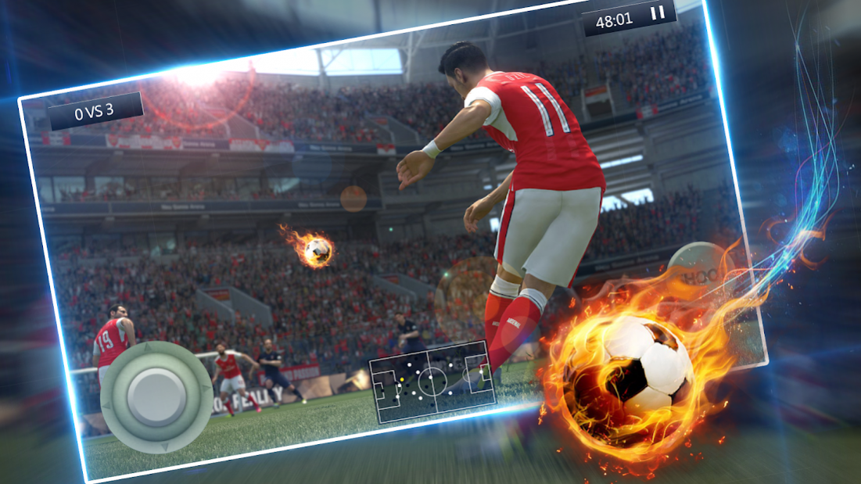
DYNAMIC MATCH SIMULATIONS
Simplified Overhead View
Animations for Key Moments

Slide 6

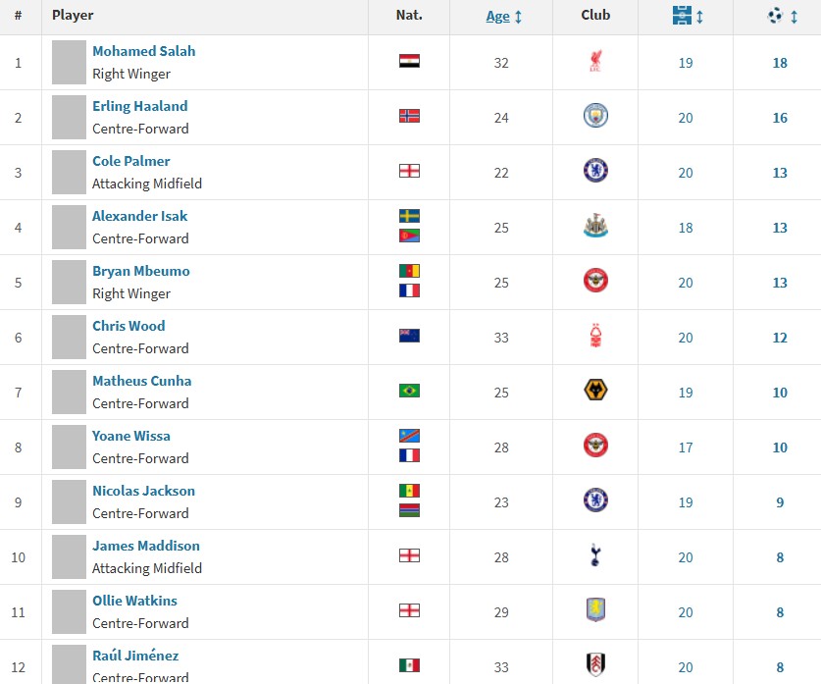

LIVE FOOTBALLER DATABASE
Use a Live API for the Footballer Database
In-Form Players Receive Stat Boosts
Location-Based Weather Affects Matches

Slide 7
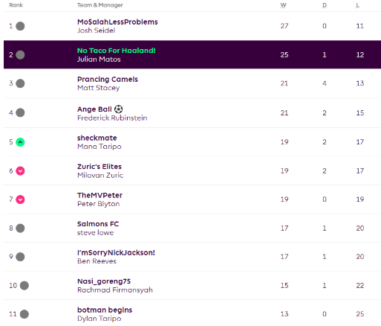
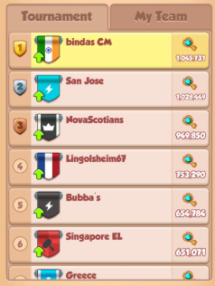
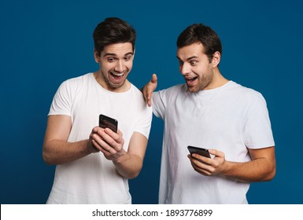
MULTIPLAYER LEAGUES & MATCHES
Create leagues for your friend group
Inspired by Coin Master
and Clash of Clans
Encourages and Thrives off of
Social Interaction

Slide 8
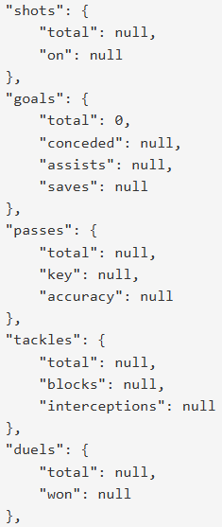
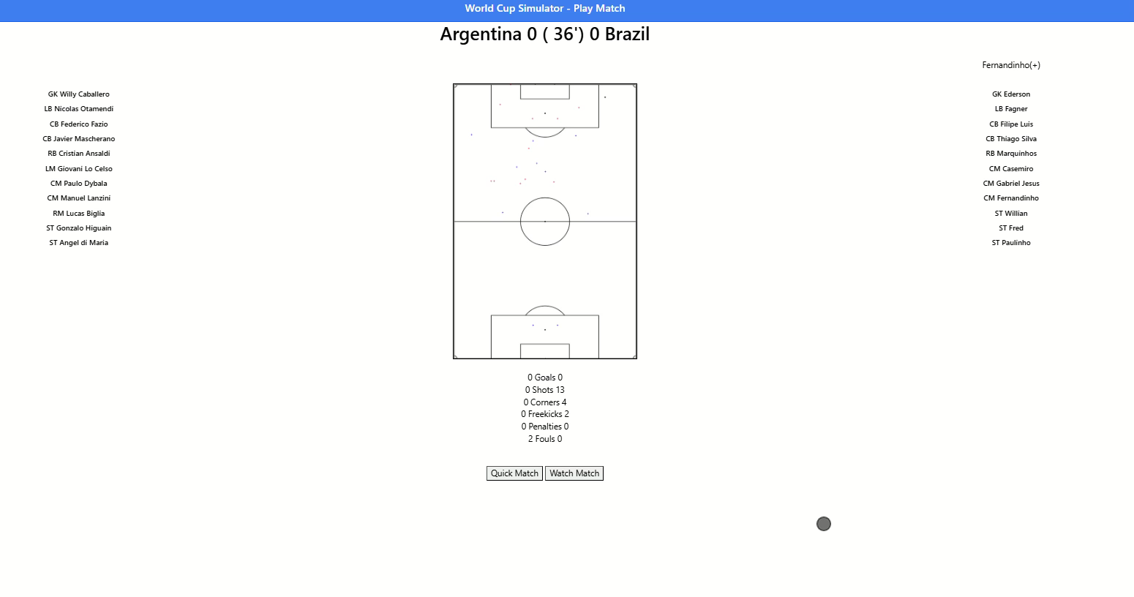
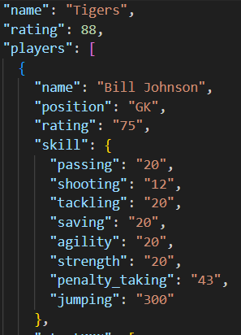
MATCH SIMULATION DEMO
Player JSON for
simulation
Player JSON from
API

Slide 9
THANK YOU!

